Slide 1
Docker
19-02-2021

Slide 2
Introduction to Containerization
Storage in Docker
Objects in Docker
Docker compose tool
Docker interaction commands
Networking
Image Management and registry
Hands on

Slide 3
Introduction to Containerization

Slide 4
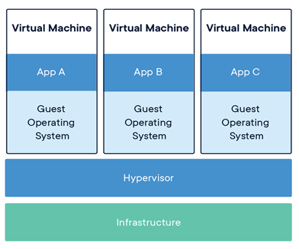
What is Containerization
Virtualization is a technique of importing a Guest OS on the top of host OS.
This technique is revolution in the beginning because Developers run the different application in different VMs all running on same host.
This eliminate the need of extra h/w resource and enable the backup allowing the recovery in failure conditions
Lowering the total cost of foundation.

Slide 5
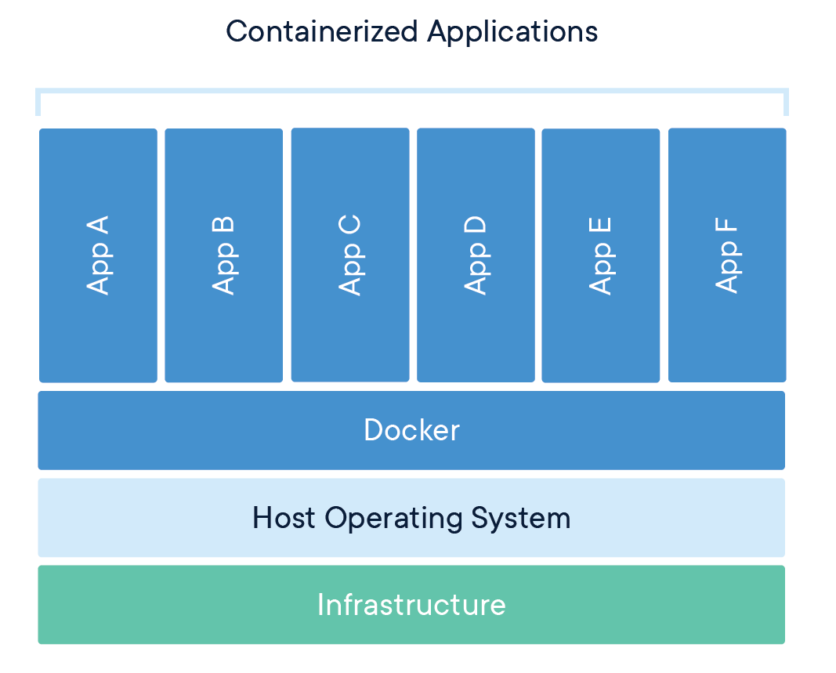
Containerization…
Packaging Software into Standardized Units for Development, Shipment and Deployment is known as Containerization
Docker is a software containerization platform, meaning you can build your application, package them along with their dependencies into a container and then these containers can be easily shipped to run on other machines.

Slide 6
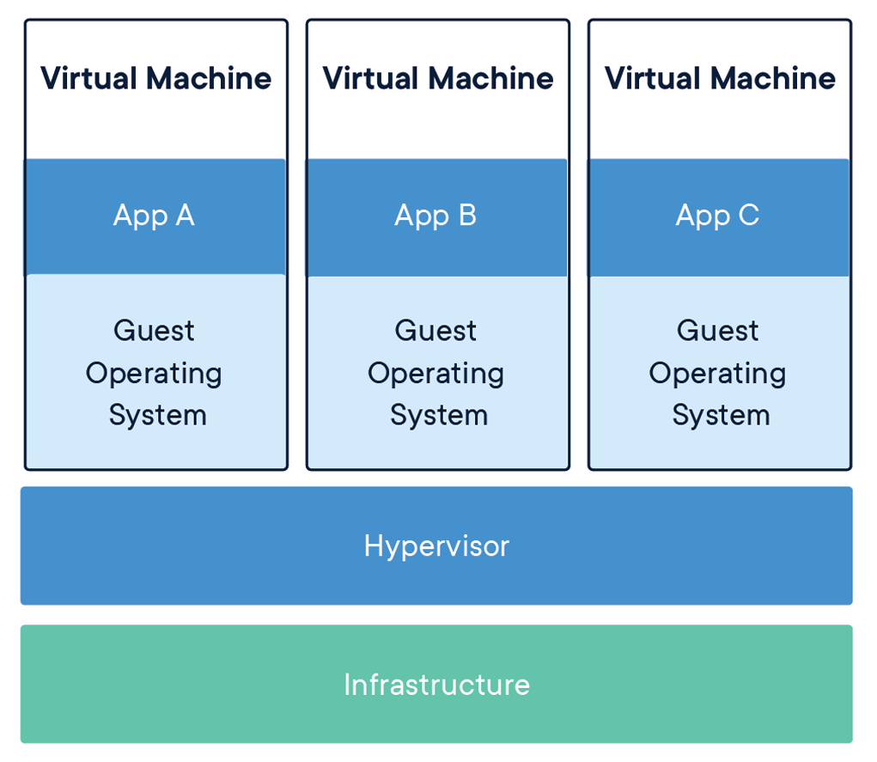
Comparing VM and Containers

Slide 7
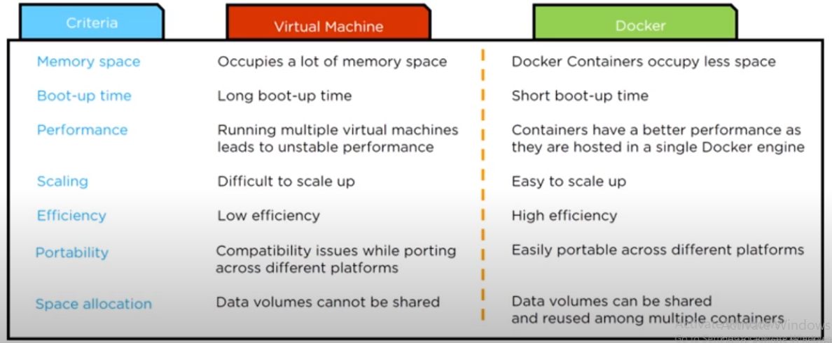
Comparing VM and Container

Slide 8
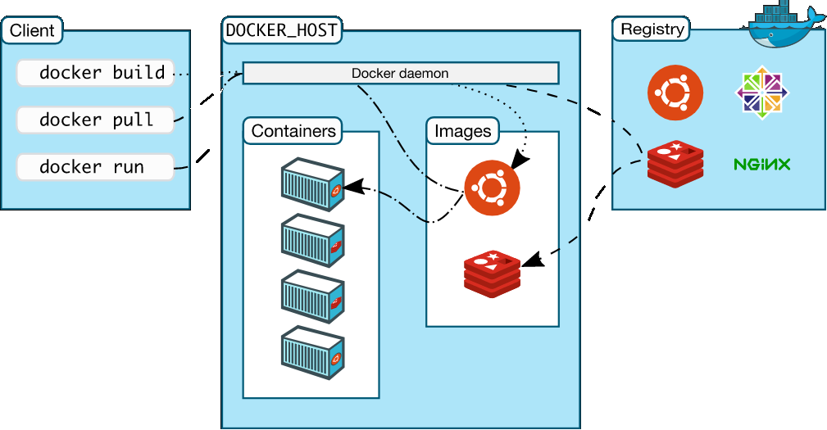
Docker Architecture

Slide 9
Docker Engine
Docker Engine is a client-server application with these major components:
A server which is a type of long-running program called a daemon process (the dockerd command).
A REST API which specifies interfaces that programs can use to talk to the daemon and instruct it what to do.
A command line interface (CLI) client (the docker command)
The CLI uses the Docker REST API to control or interact with the Docker daemon through scripting or direct CLI commands. Many other Docker applications use the underlying API and CLI.
The daemon creates and manages Docker objects, such as images, containers, networks, and volumes.

Slide 10
Objects in Docker

Slide 11
Objects in Docker
When you use Docker, you are creating and using images, containers, networks, volumes, plugins, and other objects. This section is a brief overview of some of those objects.
IMAGES
An image is a read-only template with instructions for creating a Docker container. Often, an image is based on another image, with some additional customization. For example, you may build an image which is based on the ubuntu image, but installs the Apache web server and your application, as well as the configuration details needed to make your application run.
You might create your own images or you might only use those created by others and published in a registry. To build your own image, you create a Dockerfile with a simple syntax for defining the steps needed to create the image and run it. Each instruction in a Dockerfile creates a layer in the image. When you change the Dockerfile and rebuild the image, only those layers which have changed are rebuilt. This is part of what makes images so lightweight, small, and fast, when compared to other virtualization technologies.

Slide 12
Containers
Containers
A container is a runnable instance of an image. You can create, start, stop, move, or delete a container using the Docker API or CLI. You can connect a container to one or more networks, attach storage to it, or even create a new image based on its current state.
By default, a container is relatively well isolated from other containers and its host machine. You can control how isolated a container’s network, storage, or other underlying subsystems are from other containers or from the host machine.
A container is defined by its image as well as any configuration options you provide to it when you create or start it. When a container is removed, any changes to its state that are not stored in persistent storage disappear.
Example docker run command

Slide 13
Docker Objects
Services
Services allow you to scale containers across multiple Docker daemons, which all work together as a swarm with multiple managers and workers.
Each member of a swarm is a Docker daemon, and all the daemons communicate using the Docker API. A service allows you to define the desired state, such as the number of replicas of the service that must be available at any given time.
By default, the service is load-balanced across all worker nodes. To the consumer, the Docker service appears to be a single application. Docker Engine supports swarm mode in Docker 1.12 and higher.

Slide 14
Docker interaction commands

Slide 15
Commands-stating and stopping containers
docker start [CONTAINER]
docker stop [CONTAINER]
docker restart [CONTAINER]
docker pause [CONTAINER]
docker unpause [CONTAINER]
docker kill [CONTAINER]
docker ps
docker logs [CONTAINER]
docker inspect [OBJECT_NAME/ID]
docke image ls
docker history [IMAGE]

Slide 16
Docker Image commands
docker build [URL]
docker pull [IMAGE]
docker push [IMAGE]
docker commit [CONTAINER] [NEW_IMAGE_NAME]
docker rmi [IMAGE]
docker save [IMAGE] > [TAR_FILE]

Slide 17
Image Management and Registry

Slide 18
Docker registry
A Docker registry stores Docker images. Docker Hub is a public registry that anyone can use, and Docker is configured to look for images on Docker Hub by default. You can even run your own private registry.
When you use the docker pull or docker run commands, the required images are pulled from your configured registry. When you use the docker push command, your image is pushed to your configured registry.

Slide 19
Storage in Docker

Slide 20
Storage in Docker
By default all files created inside a container are stored on a writable container layer. This means that:
The data doesn’t persist when that container no longer exists, and it can be difficult to get the data out of the container if another process needs it.
A container’s writable layer is tightly coupled to the host machine where the container is running. You can’t easily move the data somewhere else.
Writing into a container’s writable layer requires a storage driver to manage the filesystem. The storage driver provides a union filesystem, using the Linux kernel. This extra abstraction reduces performance as compared to using data volumes, which write directly to the host filesystem.
Docker has two options for containers to store files in the host machine, so that the files are persisted even after the container stops: volumes, and bind mounts. If you’re running Docker on Linux you can also use a tmpfs mount. If you’re running Docker on Windows you can also use a named pipe.
Keep reading for more information about these two ways of persisting data.

Slide 21
Choose the right type of mount
No matter which type of mount you choose to use, the data looks the same from within the container. It is exposed as either a directory or an individual file in the container’s filesystem.
An easy way to visualize the difference among volumes, bind mounts, and tmpfs mounts is to think about where the data lives on the Docker host.
Volumes are stored in a part of the host filesystem which is managed by Docker (/var/lib/docker/volumes/ on Linux). Non-Docker processes should not modify this part of the filesystem. Volumes are the best way to persist data in Docker.
Bind mounts may be stored anywhere on the host system. They may even be important system files or directories. Non-Docker processes on the Docker host or a Docker container can modify them at any time.
tmpfs mounts are stored in the host system’s memory only, and are never written to the host system’s filesystem.

Slide 22
Docker compose tool

Slide 23
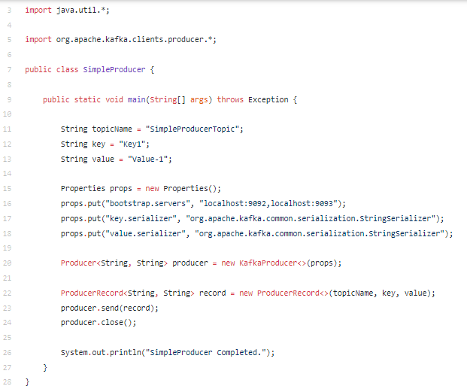
Compiling Kafka code

Slide 24
Networking

Slide 25
Docker Networking
Docker takes care of the networking aspects so that the containers can communicate with other containers and also with the Docker Host.
If you do an ifconfig on the Docker Host, you will see the Docker Ethernet adapter. This adapter is created when Docker is installed on the Docker Host.
Docker’s networking subsystem is pluggable, using drivers.
Several drivers exist by default, and provide core networking functionality:
bridge
host
none
overlay
macvlan

Slide 26
Types of Networks
bridge
The default network driver. If you don’t specify a driver, this is the type of network you are creating.
Bridge networks are usually used when your applications run in standalone containers that need to communicate.
host
For standalone containers, remove network isolation between the container and the Docker host, and use the host’s networking directly.
host is only available for swarm services on Docker 17.06 and higher. See use the host network.

Slide 27
Types of Networks
overlay
Overlay networks connect multiple Docker daemons together and enable swarm services to communicate with each other.
You can also use overlay networks to facilitate communication between a swarm service and a standalone container, or between two standalone containers on different Docker daemons.
This strategy removes the need to do OS-level routing between these containers
macvlan
Macvlan networks allow you to assign a MAC address to a container, making it appear as a physical device on your network.
The Docker daemon routes traffic to containers by their MAC addresses.
Using the macvlan driver is sometimes the best choice when dealing with legacy applications that expect to be directly connected to the physical network, rather than routed through the Docker host’s network stack.

Slide 28
Network Drivers
User-defined bridge networks are best when you need multiple containers to communicate on the same Docker host.
Host networks are best when the network stack should not be isolated from the Docker host, but you want other aspects of the container to be isolated.
Overlay networks are best when you need containers running on different Docker hosts to communicate, or when multiple applications work together using swarm services.
Macvlan networks are best when you are migrating from a VM setup or need your containers to look like physical hosts on your network, each with a unique MAC address.
Third-party network plugins allow you to integrate Docker with specialized network stacks.

Slide 29
Networking Commands
docker network ls
docker network rm [NETWORK]
docker network inspect [NETWORK]
docker network connect [NETWORK] [CONTAINER]
docker network disconnect [NETWORK] [CONTAINER]

Slide 30
Hands on

Slide 31
Docker Hands on
Docker Installation
Docker Image Commands
Dockerfile
Docker Container Commands
Docker Volume Commands
Docker Network Commands
Docker-Compose
Docker Swarm commands
Docker Node commands
Docker Service commands
Docker Stack commands

Slide 32
Questions

Slide 33
Thank you

